Slide 1


PRESENTS
SMART
EXTENSION
SYSTEM(SES)
FOR
ABUDHABI AGRICULTURE AND FOOD SAFETY AUTHORITY (ADAFSA)

Slide 2

EXECUTIVE SUMMARY
The SES will be the primary tool for the ADAFSA Agricultural Extension Engineers (AEE) to disseminate best agricultural practices and to record details of important information's.
The SES will allow instant reporting on assessment and technical advices
“
The project is focused on building a Digital solution to facilitate the recording, reporting, analysing, prioritizing and monitoring of the extension activities
“

Slide 3

FUNCTIONAL REQUIREMENTS
01
WEB APP DEV USING ASP.NET, MS SQL.
MOBILE DEVT USING REAST NATIVE
....................................................................
01
ASSESSMENT AND MEASUREMENT OF TECHNICAL DATA, FIS, AGRICULTURE SUSTAINABILITY INDEX (44 INDICATORS)
.........................................................
02
INTUITIVE DASHBOARD AND WORKFLOW MANAGEMENT
.............................................
03
GEO ENABLED SERVICES
...................................
04

Slide 4
02
RESPONSIVE WEB, MOBILE AND TABLET APPLICATION WITH OFFLINE FORMS SAVING AND ONLINE SYNC CAPABILITIES
...................................
05
CONTINUOUS FEEDBACK AND PERFORMANCE MONITORING
.............................................
06
INTEGRATE WITH OTHER PARTNER SYSTEMS
.........................................................
07
MULTILINGUAL – ENGLISH & ARABIC
....................................................................
08

Slide 5
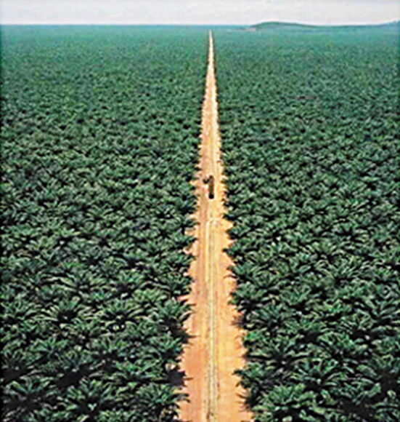
SMART EXTENSION SYSTEM
Admin
Create Components and Sub Components
Creates Activities and Tasks
Create Control Points for activities
Create Qualitative and Quantitative points
Create evaluation scales for Control Points
Create Reference Material
Manage Farmers list
SCOPE

Slide 6
Agricultural Extension Engineers (AEE)
Login using AD
Place Farm replacement Request
Lookup farm characteristics and reports from ADAFSA Database. Access to previous reports in “Read only Mode
Assessment of Farms
Look up Reference Material
Data Capture(Evaluation Results) using the SES Application
Evaluation Request send for approval
Evaluation results sent to farmer after approval
SCOPE

Slide 7
Extension Center Manager
Raise Request for Farm Replacement
Review and edit the farm report if needed before approving it to sent to farm owner.
SCOPE

Slide 8
Area Manager and Section Manager
Area Manager - Approve/Reject Farm Replacement request from Extension Center Manager
Section Manager - Approve/Reject Farm Replacement request from Area Manager
Reports on specific agricultural practices, performance of AEE, statistical data of various farming systems
Altering Subject Matter Specialists (SMS)
Monitoring and evaluation of regional programs and technical staff;
Mobilizing regional human and material resources.
SCOPE

Slide 9
Farm Owners
Receive Farm Visit Notifications
Farm Owners by accessing “Mazraati” can
read the reports related to their respective farms to take appropriate actions.
View Reports
SCOPE

Slide 10
Farm Relations Manager & Assistants
Access the reports prepared by AEE in “Read only”
Report of all AEE working under their supervision
SCOPE

Slide 11
Subject Matter Specialists
Access the individual AEE reports
Identify specific technical training needs of AEE.
Provide sound recommendations for TSD Management and Technical Units
SCOPE

Slide 12
Director of TSD and SES Advisory
Committee
Access to all high level reports
Make management decision
Assessment of AEE’s performance using KPIs
Provide ADAFSA Executive Management & Decision Makers with sound suggestions to policies and strategies
SCOPE

Slide 13

01
01
USER FRIENDLY DASHBOARDS WITH SERVICE REQUEST TRACKING FACILITY
02
EASIER ACCESS TO MOCCAE ONLINE SERVICES
APPLICATION
COMPONENTS.
BASIC MOBILE APP FEATURES LIKE FAQ, RATING, CONTACT US, REQUEST STATUS TRACKING ETC.
03
FOLLOW THE MOST MODERN DESIGN & DEVELOPMENT PRACTICES (03 SAMPLE DESIGNS WILL BE PROVIDED)
04

Slide 14
02
05
MOBILE APP DEVELOPMENT USING FLUTTER
06
PUSH NOTIFICATIONS (AUTOMATIC & MANUAL)
07
INTEGRATE WITH OTHER GOVERNMENT PARTNER SYSTEMS
08
INTEGRATE WITH OTHER GOVERNMENT PARTNER SYSTEMS

Slide 15
SIMILAR
PROJECTS

Slide 16
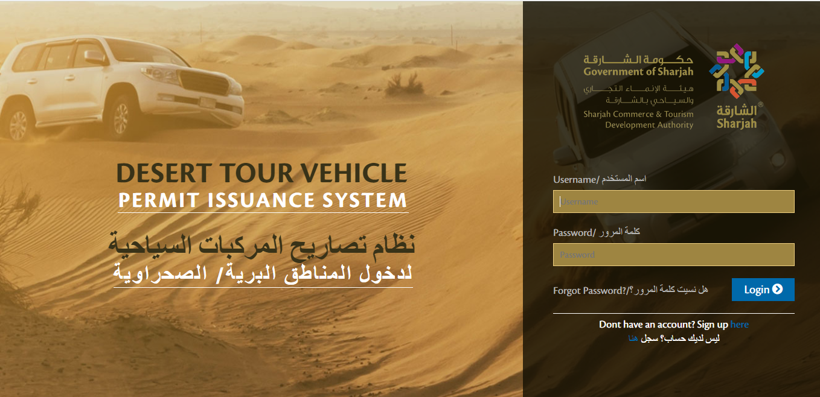
DESERT TOUR VEHICLE
PERMIT ISSUANCE SYSTEM
01
Login Page

Slide 17
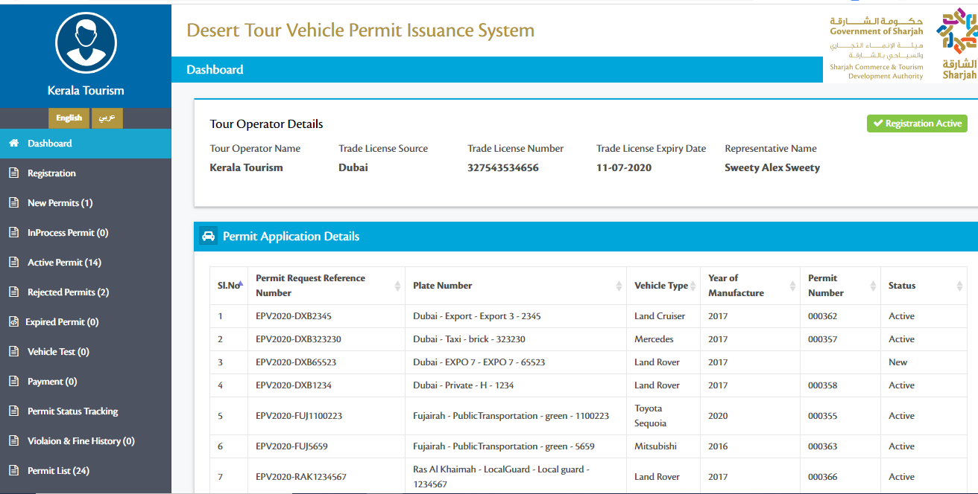
Tour Operator Dashboard

Slide 18
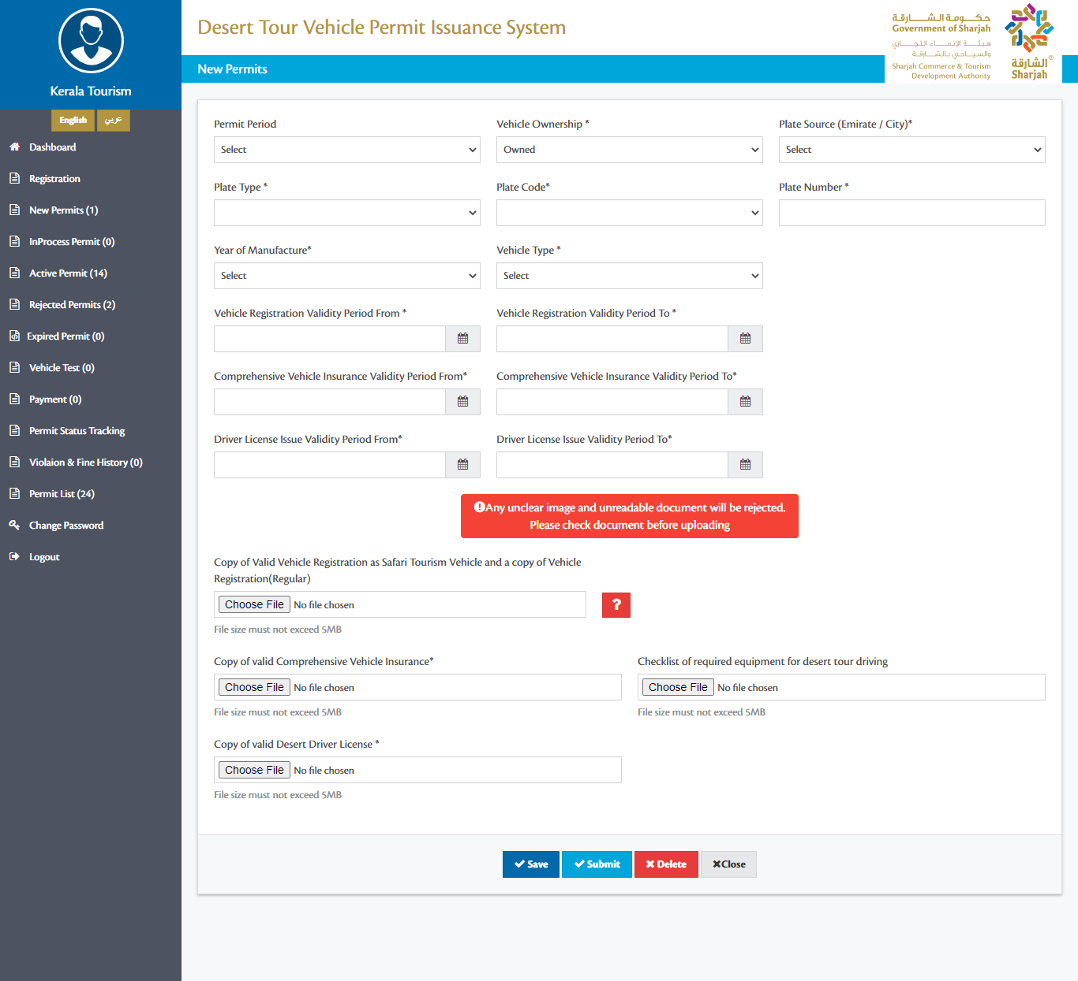
Request New Permit

Slide 19
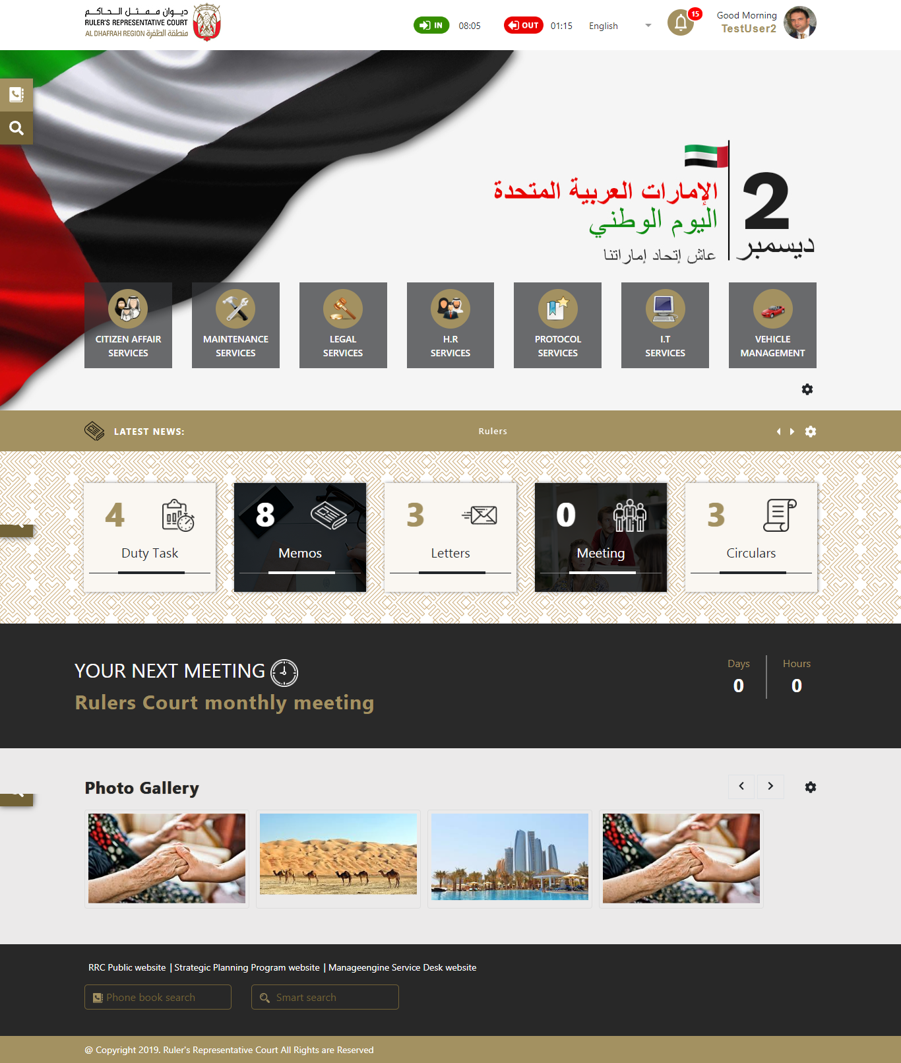
02
SMART COURT
MANAGEMENTSYSTEM
Home Page

Slide 20
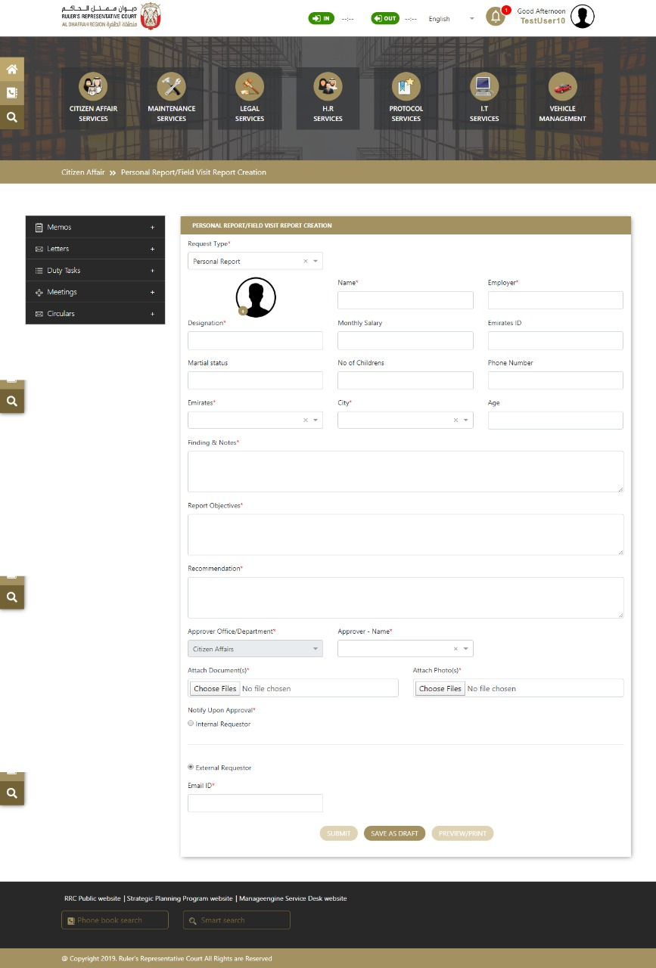
Citizen Affair - Personal Report

Slide 21
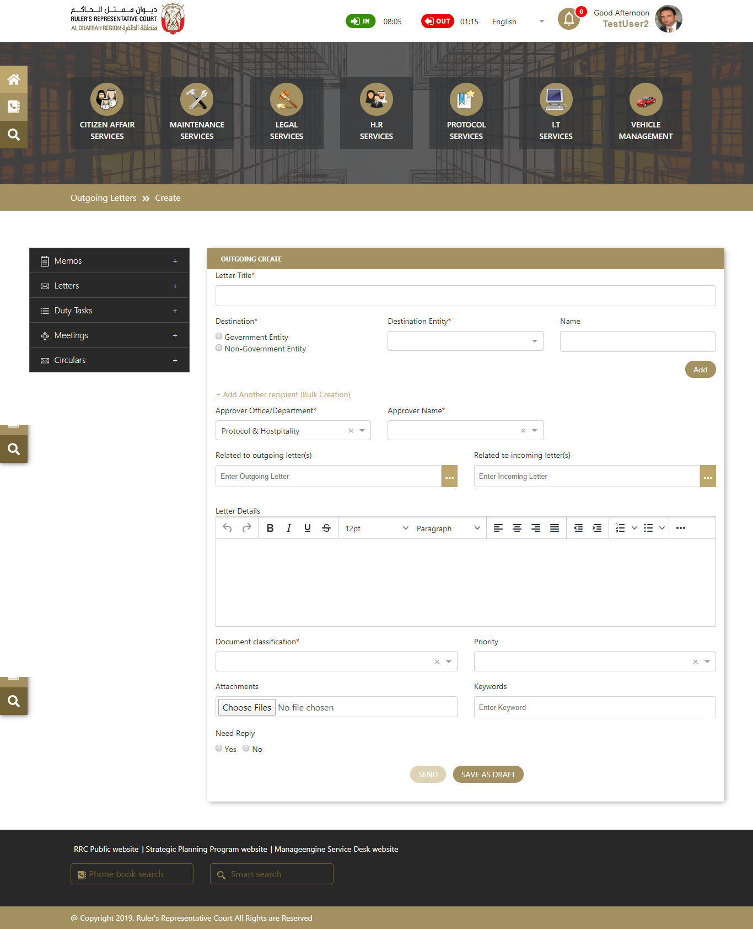
Letter creation Page

Slide 22
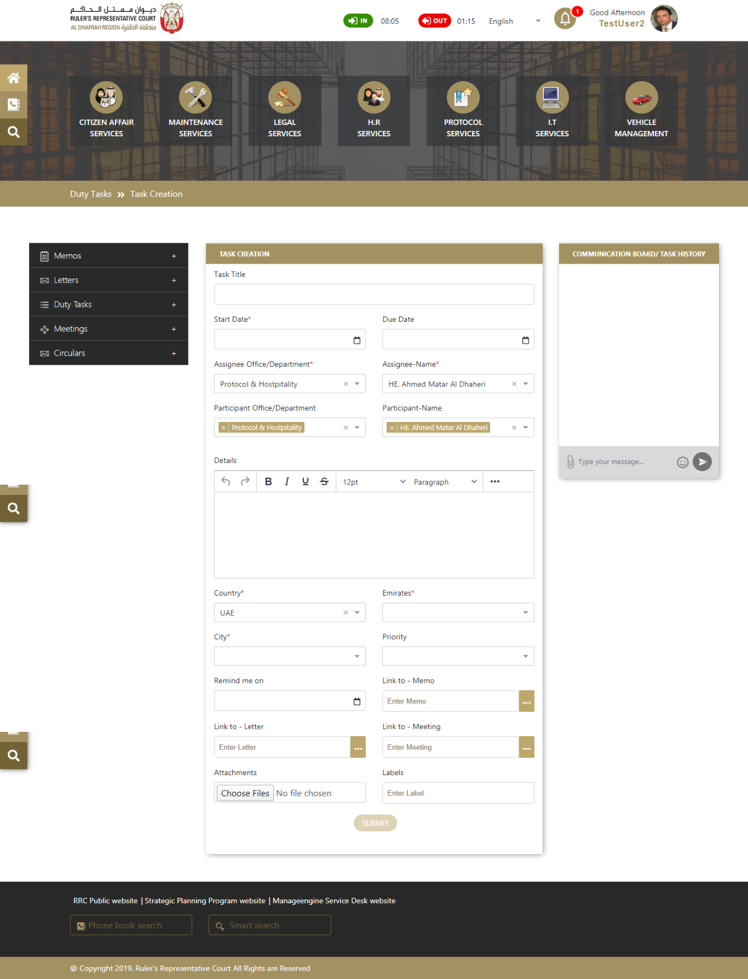
Duty Task Creation Page

Slide 23
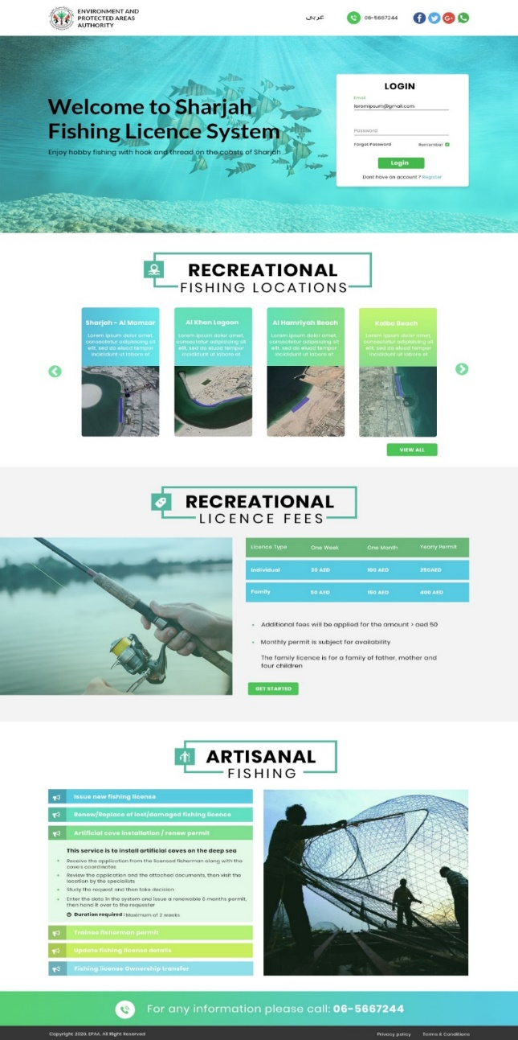
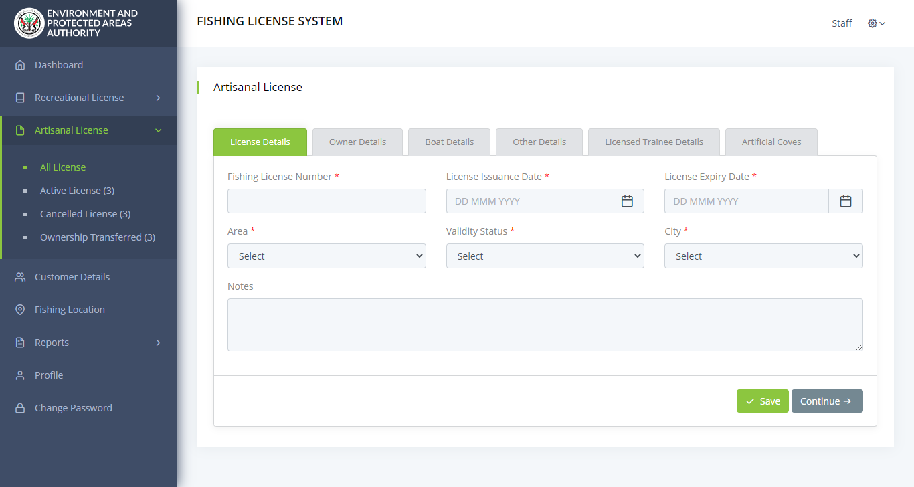
03
FISHING
LICENSE SYSTEM
EPAA Website Design
Create Artisanal License

Slide 24
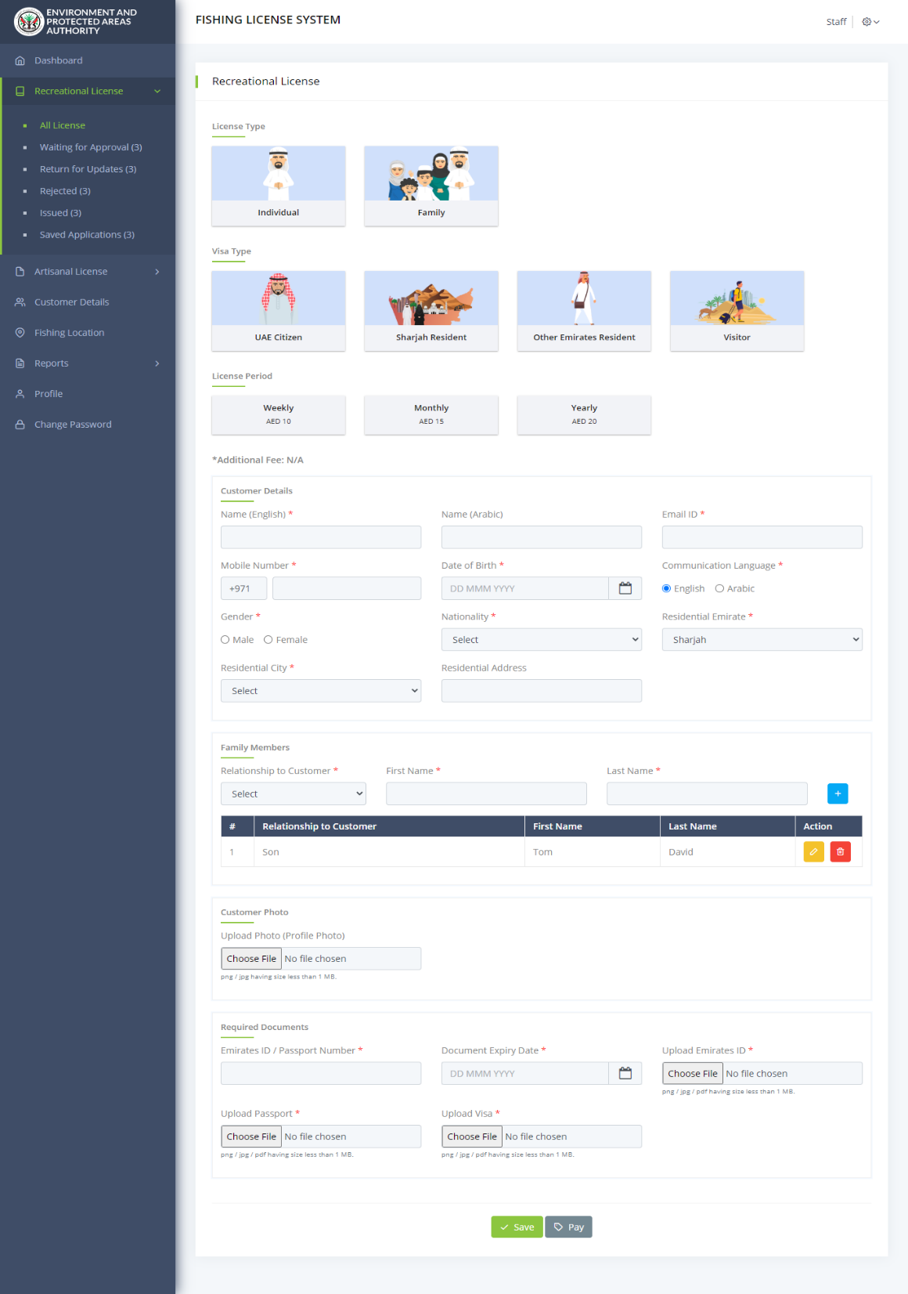
Create Recreational License

Slide 25
PROJECT MANAGEMENT METHODOLOGY
Requirement Gathering
Verbat works with various stakeholders to identify User requirements.
Coding
Error free executable programs are created using the designs developed in previous steps
1
5
Feasibility Study Through POC’s Verbat will verify if it can meet the client requirements
Testing Implemented in all phases from req. gathering to coding. Over 50% of effort is used in testing.
2
6
System Analysis The team will analyze the project to determine Scope, Limitations, Resources and Schedules
Implementation Software is tested for portability and adaptability and integration issues are solved.
3
7
Software Design The requirements are translated to logical & physical designs accompanied by pseudocode
Operation and Maintenance Users are trained with sufficient documentation to operate the software correctly
4
8

Slide 26
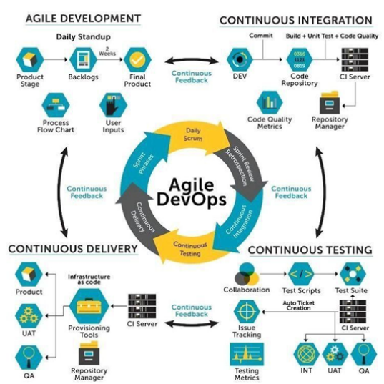
SOFTWARE RELEASE AND DEPLOYMENT

Slide 27
HIGH LEVEL PROJECT PLAN
Initiation
Prototype, & Documentations
Prototype/UI/UX Approval
Development & QA
DB Design
Coding
Testing
QA
Deployment & Maintenance
UAT
Sign-off
Warranty /Support
Administrative tasks (Contract, Advance payment)
Project Kick-off
Other Documentation Deliverables
BRD/SRS creation and approval
Prototype/UI/UX Initiation
On Project Approval
96 days from Prototype/UI/UX Approval
After 20 days
After 14 Days Development

Slide 28

PROJECT MANAGER
PROJECT
TEAM
BUSINESS ANALYST TEAM
PROJECT COORDINATION TEAM
DELIVERY MANAGER
DESIGN TEAM
DEV TEAM
QA TEAM
TECH WRITER

Slide 29
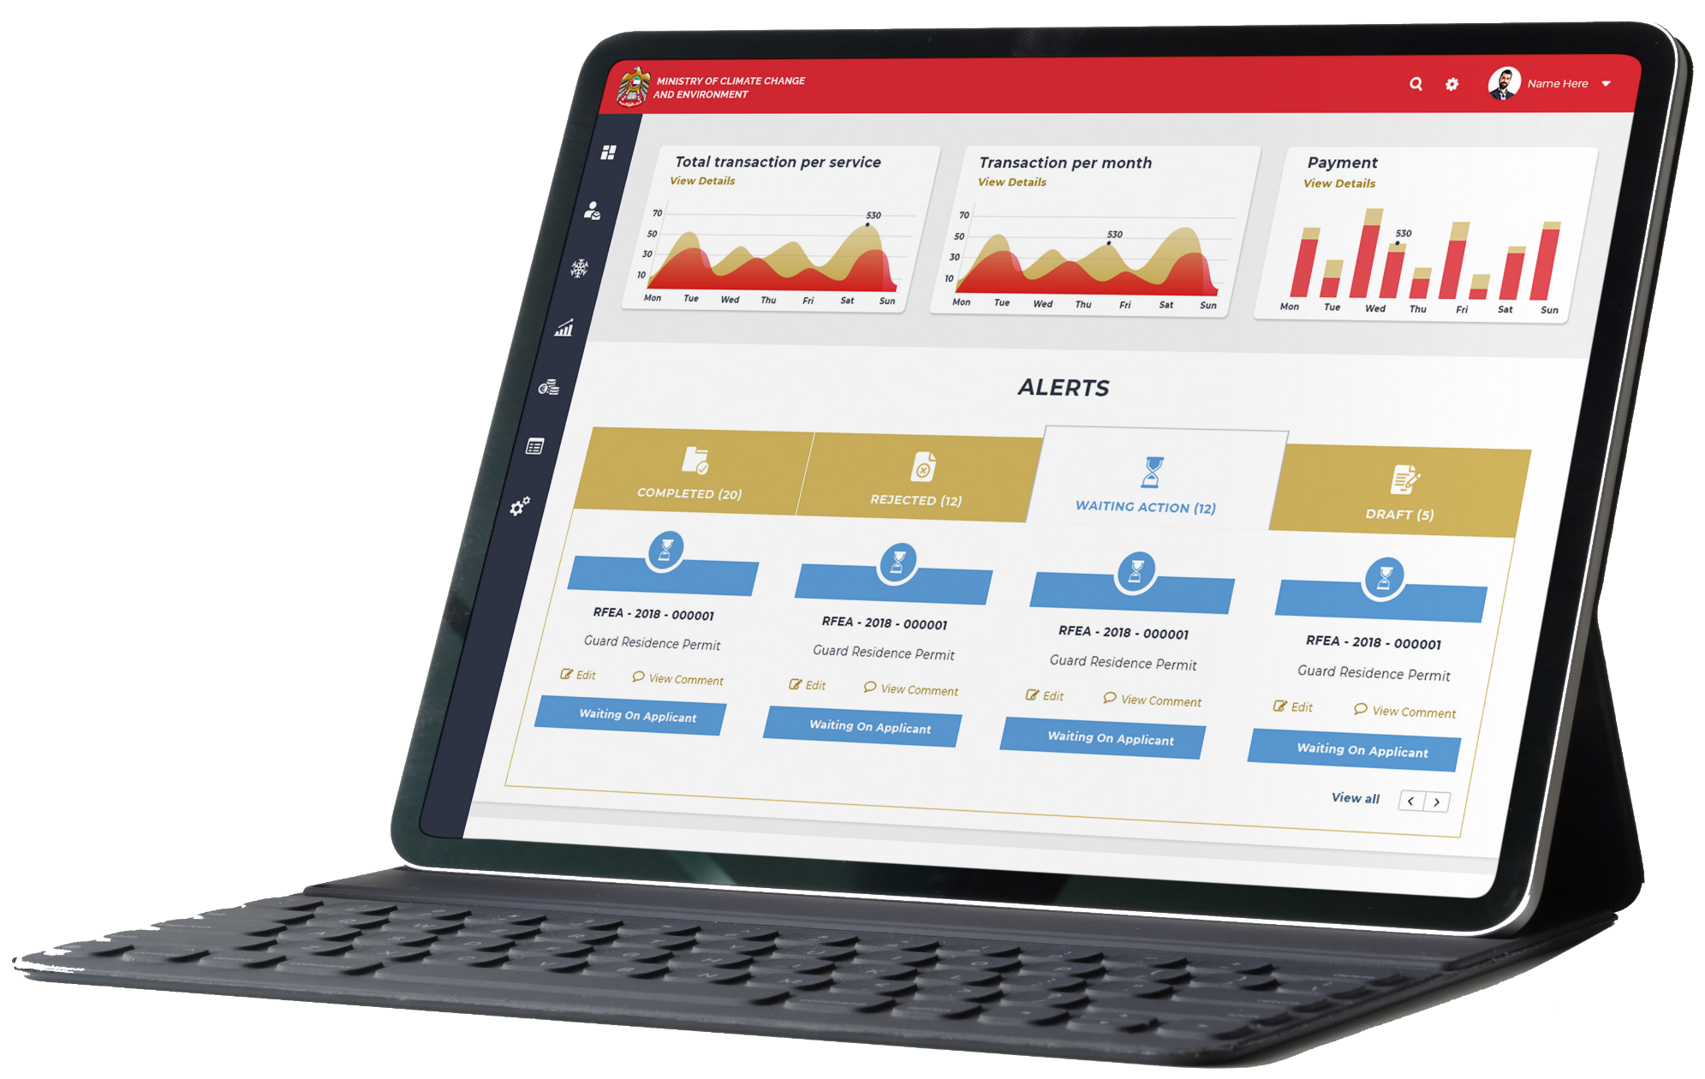
TECHNICAL
DETAILS

Slide 30
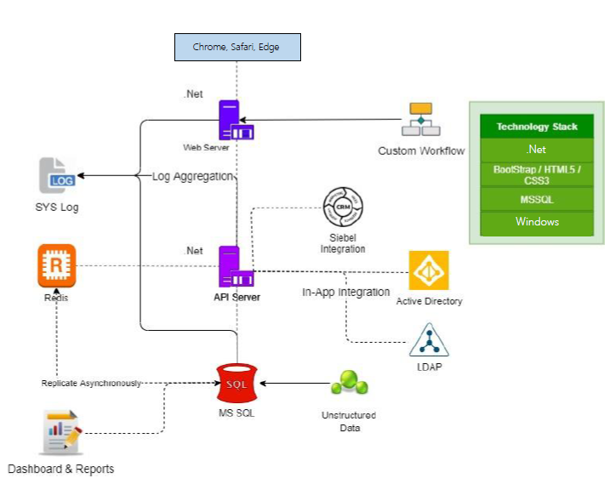
MINIMUM VIABLE ARCHITECTURE

Slide 31
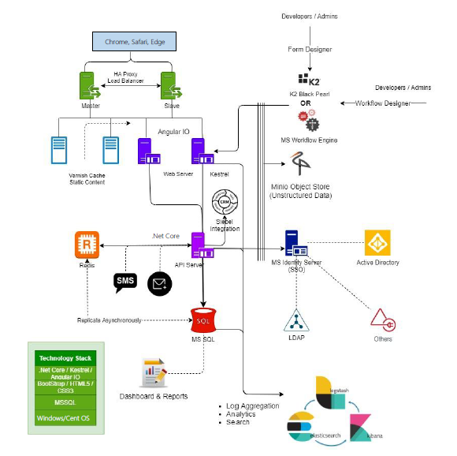
SCALABLE ARCHITECTURE

Slide 32





Globally Accredited Software Consultation Partner
IT Strategy, Application Development, Maintenance and Testing Services, Information Management, Digital Marketing
WHY VERBAT
Nearly two decades of development experience to Global Corporates and Government
Verbat is a Digital Technology Services company with over 20 years of experience in delivering Internet and Mobile Solutions to Enterprises, through Agile Development and Application Management Methodologies.
Domain specialists in Banking, Retail, Logistics, Construction, Fashion, Manufacturing, Hospitality, Automotive, Government & Healthcare
Spearheaded by a team of Technology and Management Leaders

Slide 33

[
[
Q A
&

Slide 34




At Verbat, we are committed to make IT services a pleasant experience. As such we always welcome your enquires, feedback and suggestions
Let’s Hear From You
Get in Touch
217, Sheikh Rashid Building PO Box 56272, Dubai
+971 4 2973236
USA 600 Eagle View Blvd, Suite 300
Exton Pa 19341
INDIA Level III, PTC Tower, Nanthancode, Trivandrum, Kerala
Luay.houri@verbat.com

Slide 35
A VERBAT
THANK YOU
PRESENTATION

Slide 36




ADMIN
BUSINESS USERS
Basic Administrative Functionalities
Business Users who avail the MOCCAE Services
MOCCAE STAFFS
INDIVIDUAL USERS
Maintenance and Management of E-services and Mobile Application
Responsible for necessary approval workflows
Individual users who avail the MOCCAE services.
PROPOSED SYSTEM USERS

